Slide 1
Credit One Report
Alex Guevara

Slide 2
Objectives
Define Credit One business question
Consider business impact of key features influencing default status
Outline Analysis Plan for Credit One
Process and analyze data collected over 6 month period
Highlight Future Insights
Provide Credit One best recommendations based on project findings

Slide 3
Credit One Business Question
Credit One notes the negative business impact of increasing loan defaults secondary to credit limits that may be too high for a portion of their consumers.
How can Credit One improve threshold credit limits for its customers to prevent defaulting loans therefore improving greater ROI?
Notes:
Business question
What is the stated business question?
What is the intent underlying the question (e.g., what is the context, what is the impacted segment, and what are stakeholders’ current thoughts about the underlying reasons?
What business considerations (e.g., stakeholders, timeline, and cost) are likely to impact the analysis?
Stakeholders time (meetings)
Analysis Time

Slide 4
Business Impact
Considerations that may impact Credit One default status over a 6 month time period
  Are younger credit consumers defaulting with higher credit limits?
  Is credit limit adjusted based on other factors?
    Education level
    Credit re-payment patterns
      non-consumption, payment in full, revolving credit, delayed payments
    Marital status
    Gender
Notes:
Business question
What is the stated business question?
What is the intent underlying the question (e.g., what is the context, what is the impacted segment, and what are stakeholders’ current thoughts about the underlying reasons?
What business considerations (e.g., stakeholders, timeline, and cost) are likely to impact the analysis?
Gender (male vs female)
Education levels (graduate school, university, high school, and other)
Marital status (married, single, divorced, other)
Age (21-75)
Consumer purchasing versus payment patterns
Credit repayment patterns (non-consumption, payment in full, revolving credit, delayed payments)

Slide 5
Data Analysis

Slide 6
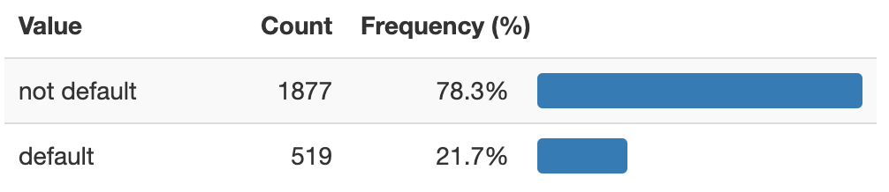
Default Status Frequencies
The percent of Defaulted Clients is nearly 22%, impacting loss of revenue and Credit One Clients
How can we decrease default rates and increase business opportunities for Credit One?

Slide 7
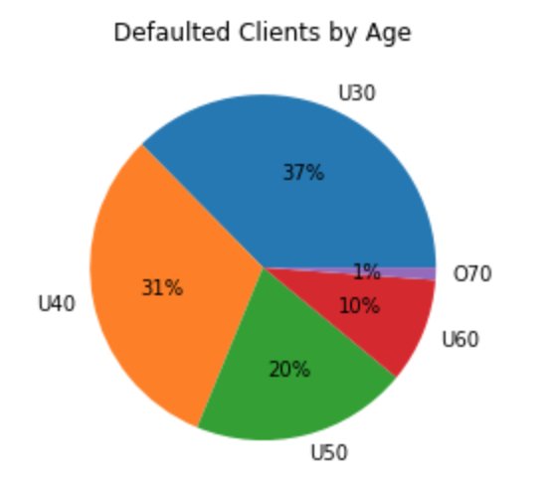
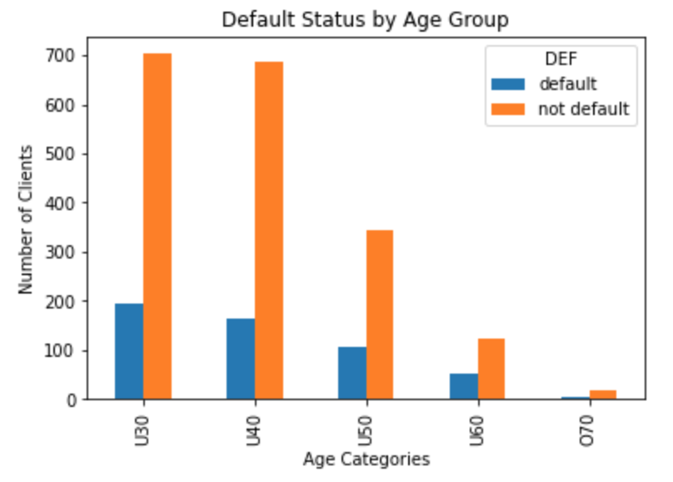
Default Status by Age
By Age Category, the Under 40 and Under 30 age groups encompass 68% of defaulted clients
The Under 30 and Under 40 age groups yield similar number of defaulted clients

Slide 8
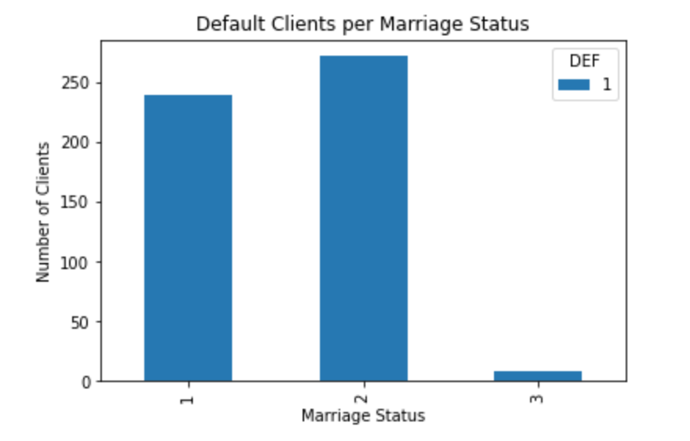
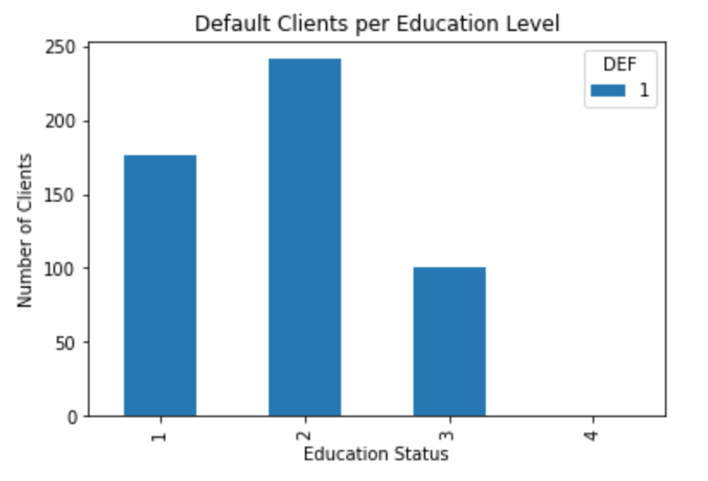
Default Client Trends
There are more defaulted Graduate School (1) and University (2) Clients than High School (3) Clients
There are more defaulted Married (1) and Single (2) Clients than Divorced (3) Clients

Slide 9
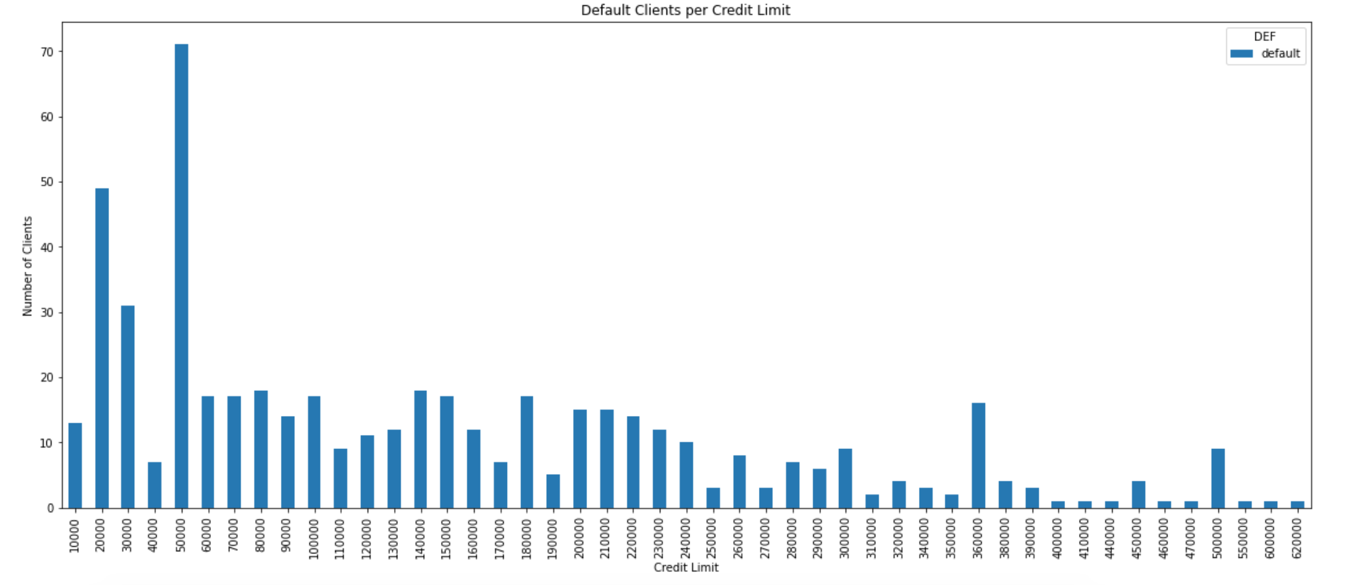
Defaulted Credit Limits
Mean | St Dev | Min | 25% | 50% | 75% | Max
$145K | $121K | $10K | $50K | $110K | $210K | $620K

Slide 10
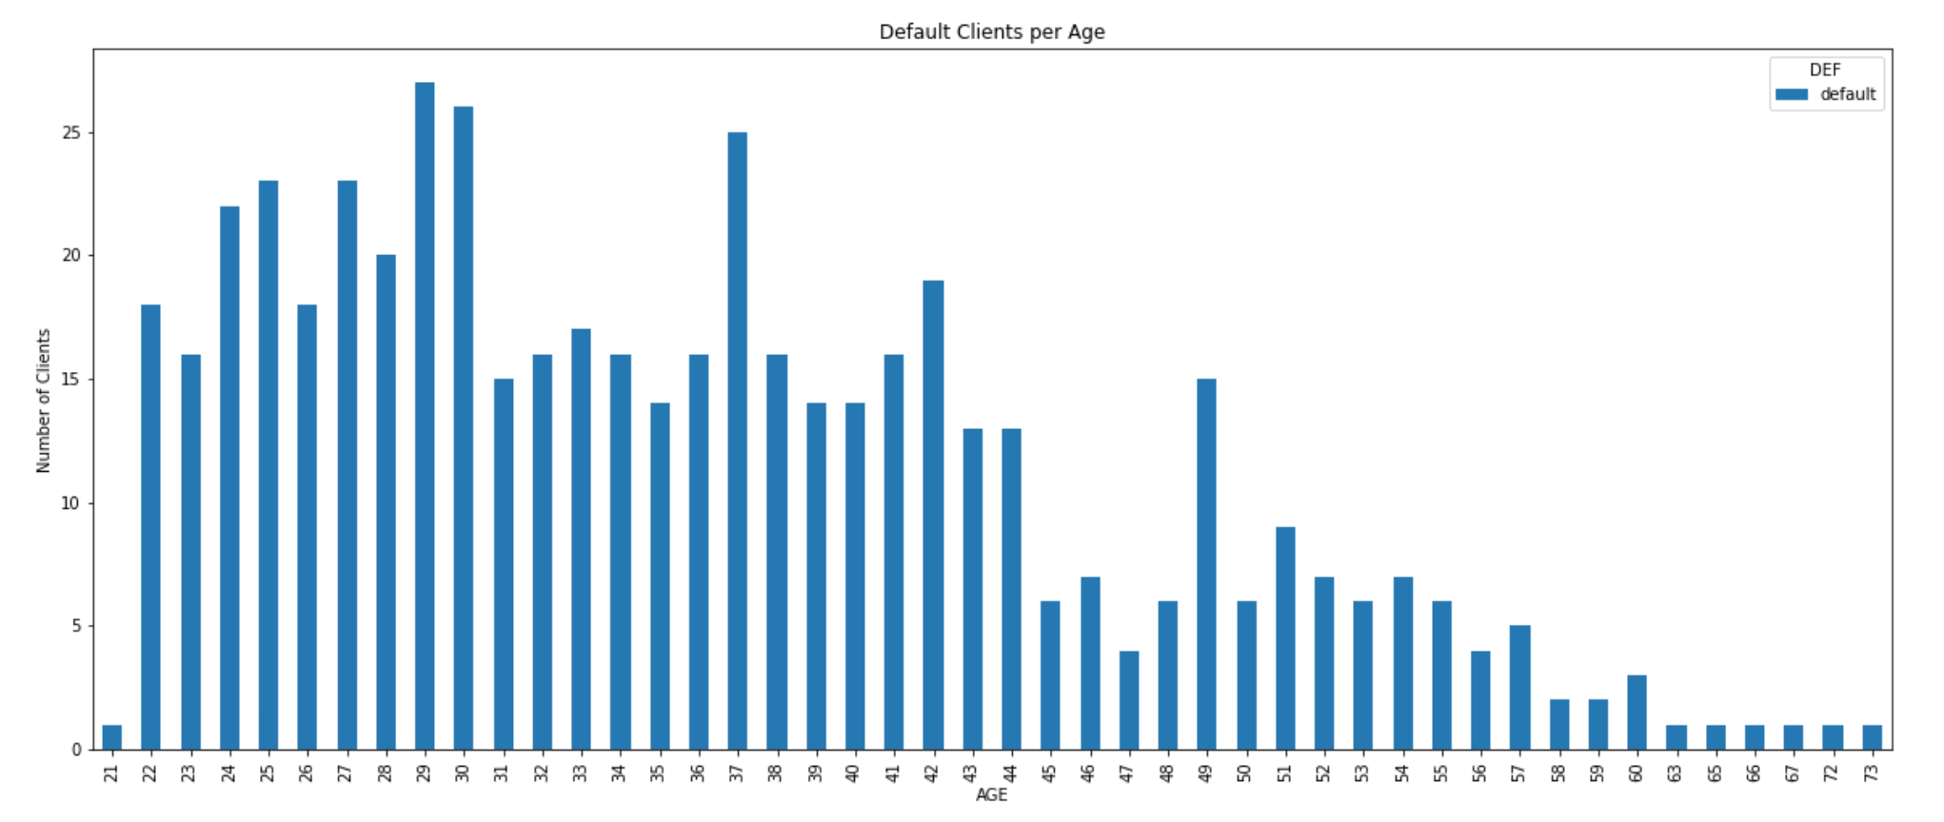
Default Clients by Age
Mean | St Dev | Min | 25% | 50% | 75% | Max
36 | 10 | 21 | 28 | 35 | 42 | 73

Slide 11
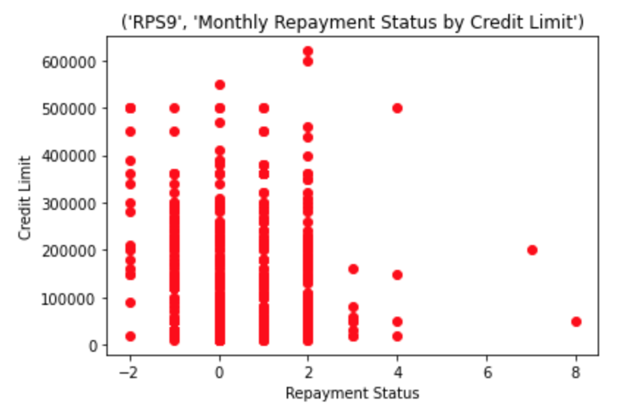
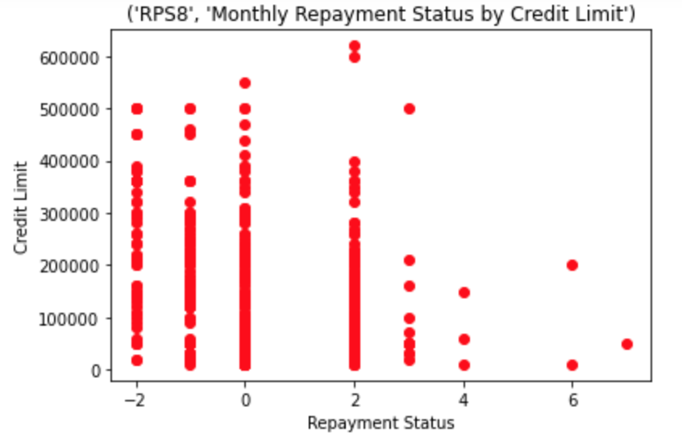
Default Client Repayment Status
Based on September and August Months
  Lower credit limit default clients are taking longer to repay
Future Considerations
Re-analyze delayed payments in the 3rd and 4th quartile
RPS | Min | 25% | 50% | 75% | Max
September | -2 | 0 | 1 | 2 | 8
August | -2 | -1 | 0 | 2 | 7
July | -2 | -1 | 0 | 2 | 7
June | -2 | -1 | 0 | 0 | 7
May | -2 | -1 | 0 | 0 | 7
April | -2 | -1 | 0 | 0 | 8

Slide 12
Modeling & Predictions

Slide 13
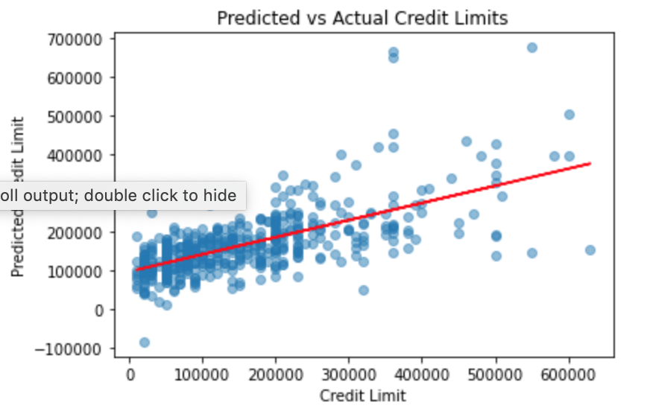
Regression Results
Statistics
Predicted r2 | 0.429
Adjusted r2 | 0.395
Mean Squared Error | 8.5x10⁹
Root Mean Squared Error | 9.2x10⁴

Slide 14
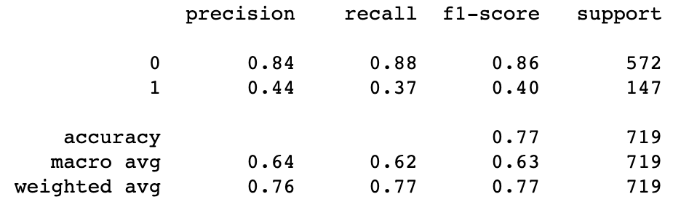

Default Status Classification Results
Summary of Features
Marriage
Repayment Status (September through April)
Sex (M, F)
Education (Grad, HS, Other, University)
Age Category (all)
Credit Limit Category
This model predicted default status of Features listed above about 77% accurately.

Slide 15
Credit One Potential Business Value
Defaulted clients comprise of 22% of all clients impacting loss of revenue
Combined, 68% of defaulted clients are comprised of Under 40 and Under 30 age groups
Per Credit Limit, the average default credit limit was $145,000
The average age for defaulted clients is 36 years old
There is a trend of lower credit limit clients who take longer for repayment

Slide 16
Summary of Findings
It was difficult to establish a good correlation for credit limits based on the data presented by Credit One with linear regression models
Data analyzed via classification problem yielded the following:
  Out of all the Credit One clients, the model predicted non-default status clients using features selected about 88% correctly
  Under this model, Non-default status was predicted well at 84% accuracy, although it was more difficult to predict default status at 44% accuracy
More data may be required to fully establish understanding of Credit Limits for both linear regression models and classification models

Slide 17
Future Recommendations for Credit One
Look only at Age Cat U30 and U40 for additional trends and re-run models
Look only at under 210K (<75% defaulted clients) credit limit and re-run models
Collect additional 6 to 12 months of data to better capture trends and re-run all models

